Slide 1




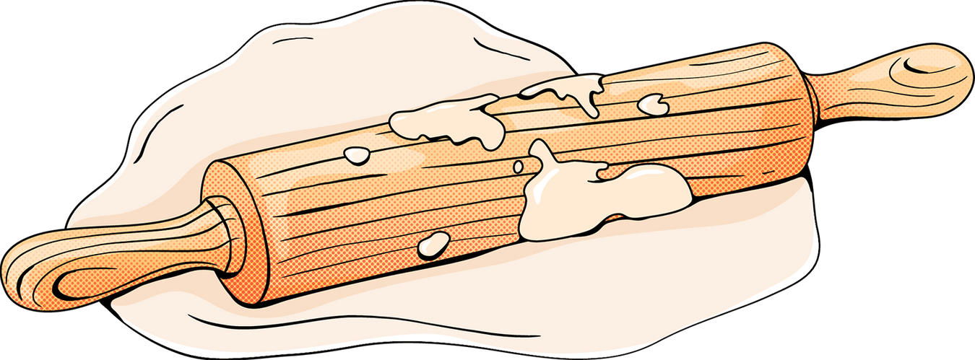
MEAL PREP HACKS
Commit to eating well with these tips

Slide 2


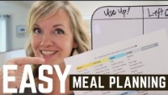
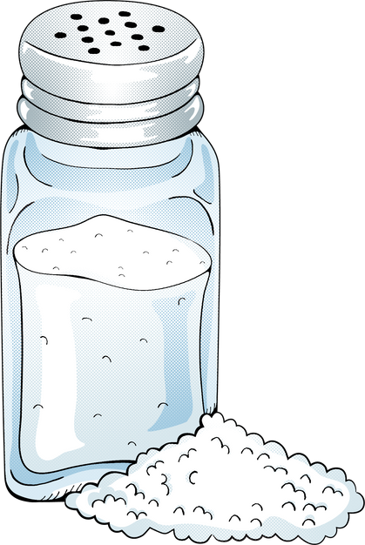
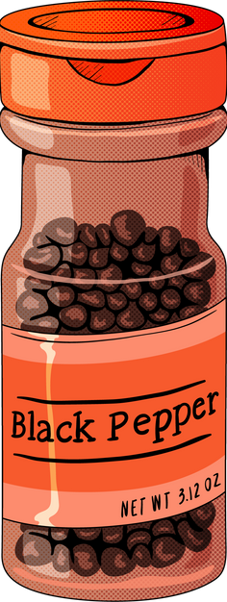
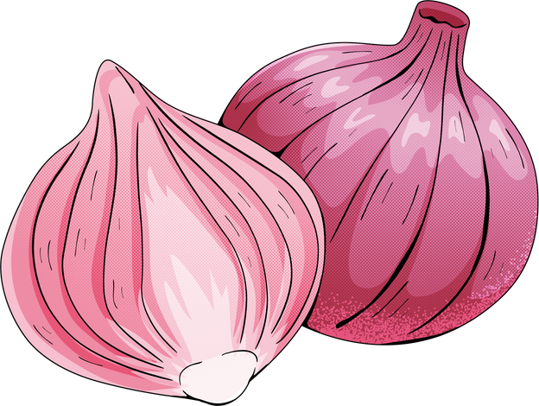
Talk with your family.
Know their favorite meals and dishes they are keen to try.

Slide 3

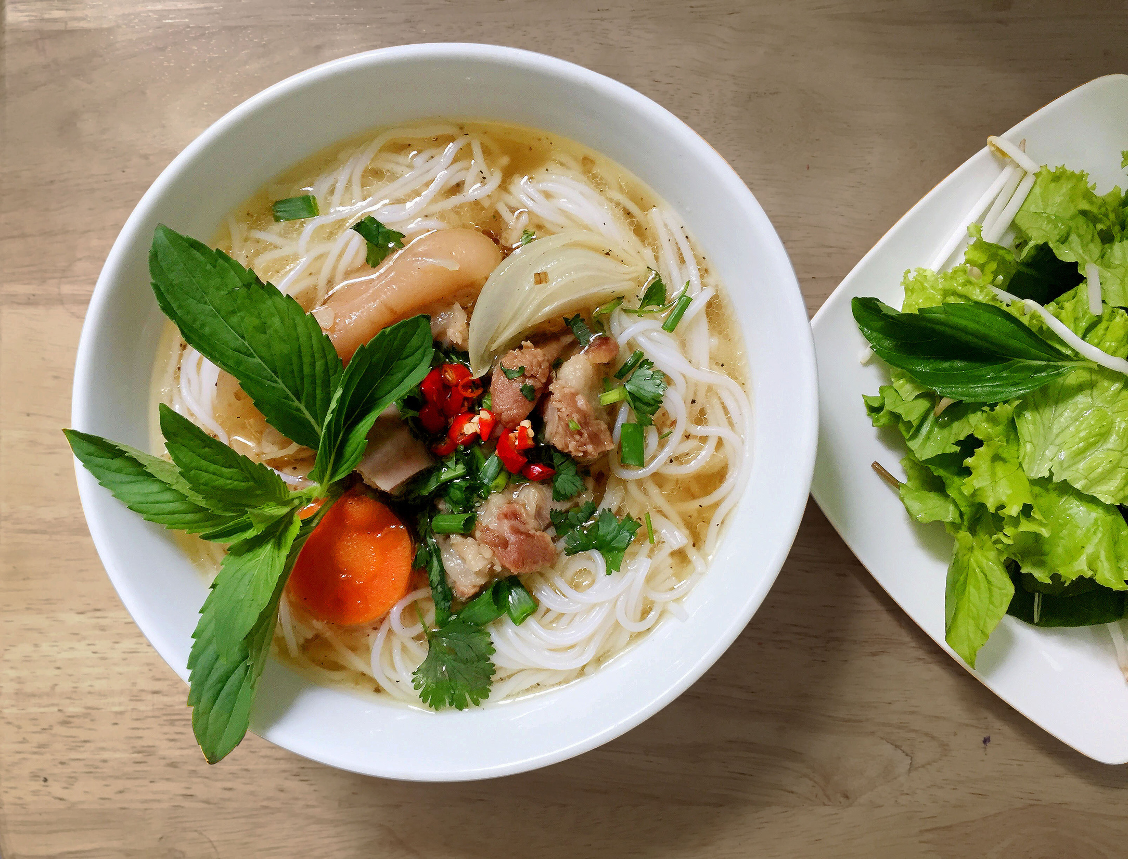
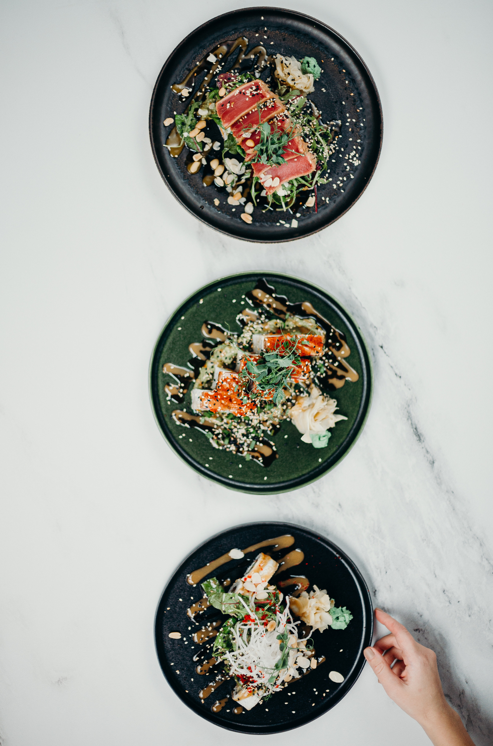
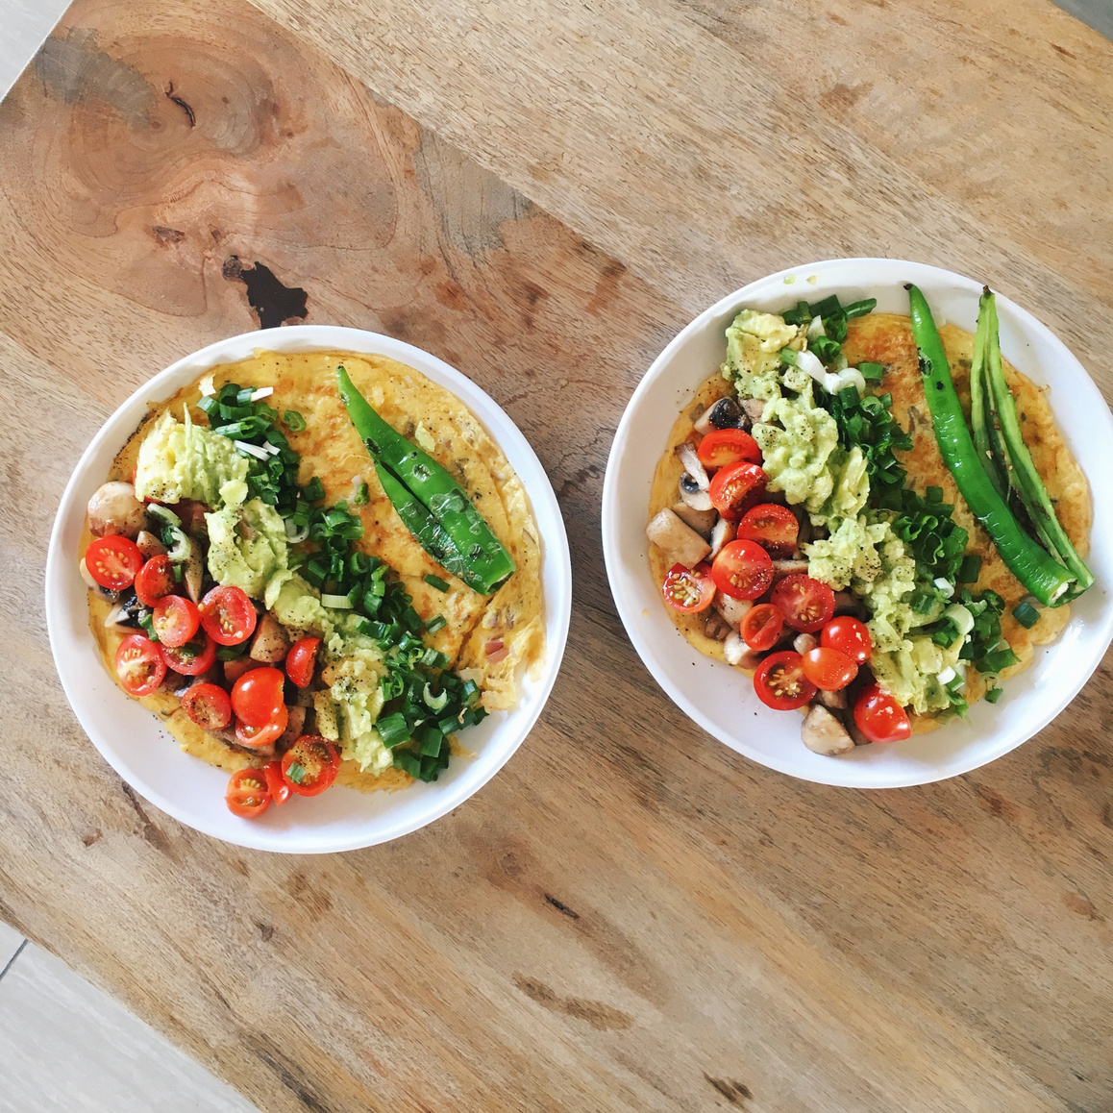

Research
healthy recipes.
Intentionally insert dishes
made with vegetables, fruits, and grains.

Slide 4

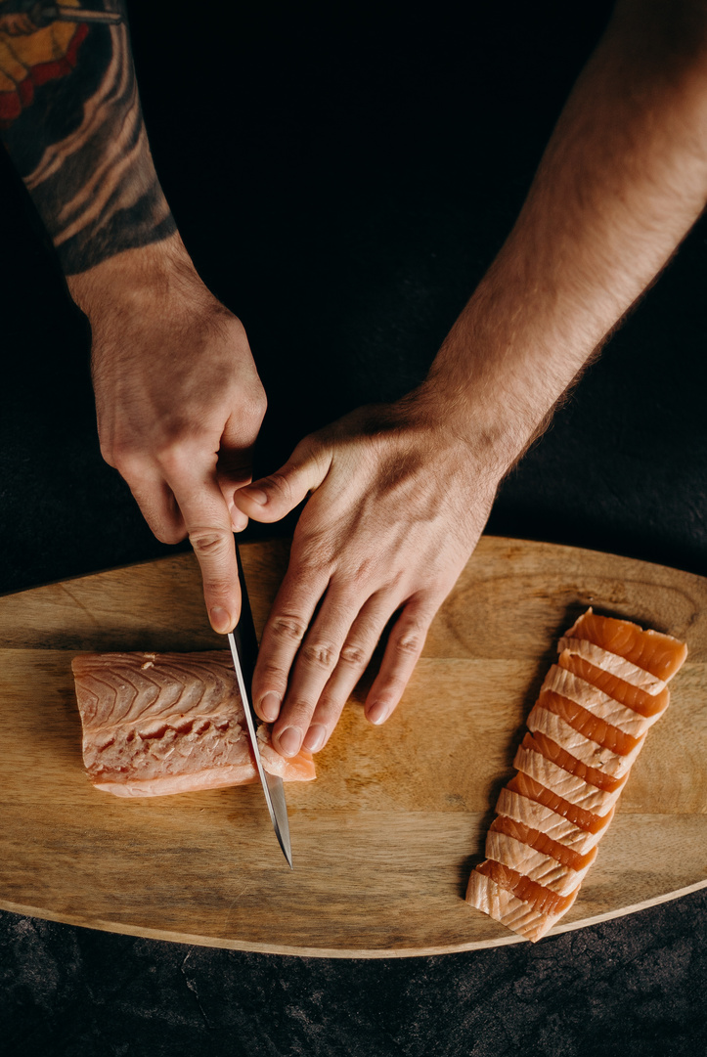
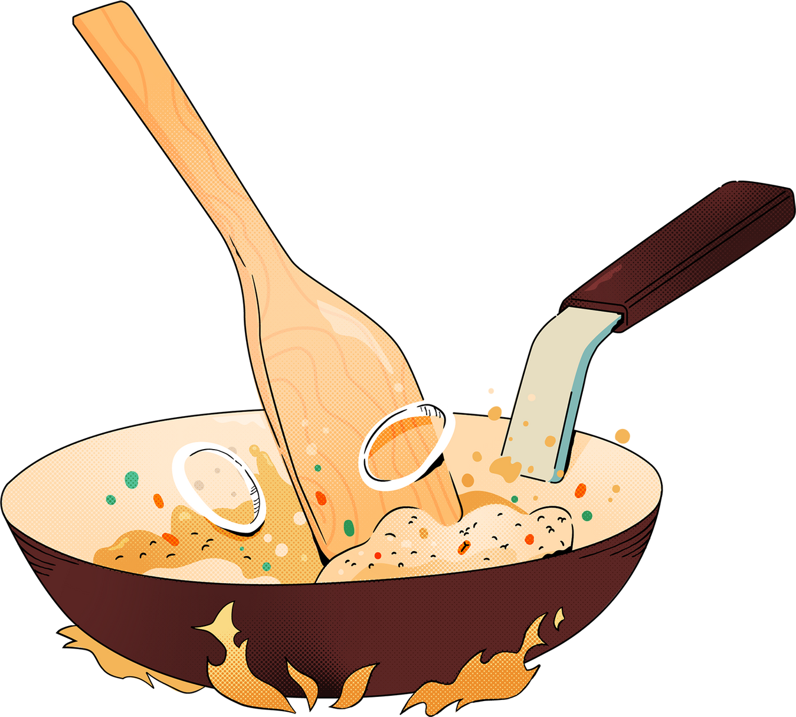

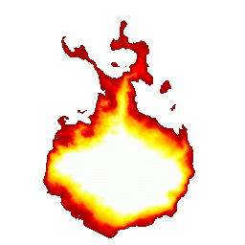
Automate breakfast.
Try out Beshbarmak Mondays, Ice Cream Thursdays, or Fried Chicken Fridays so your family has food traditions to look forward to.
Overnight oats, cereals, fruits, and granola are no-stress breakfast ideas you can incorporate on a daily basis.
This makes meal planning easier to predict too.
Make meal
planning exciting.

Slide 5

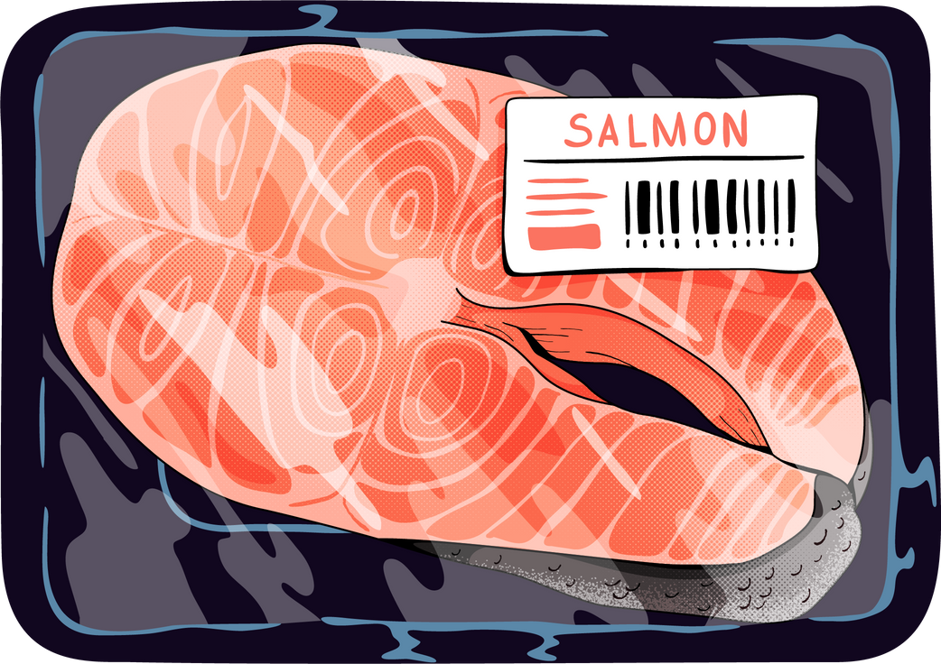
Start small.
Whipping up dinners good for 2 to 3 days a week should be a good place to begin meal prep at home.
Stock up
on staple ingredients.
This makes food shopping less frequent and a lot cheaper too.
Have enough containers.
Keep food by portion size while following
proper storage to prevent spoilage.

Slide 6
Conclusion
In my presentation I used white and blue colours. I think they match according this article (Белый и синий | (lookcolor.ru)). The unique attributes of the presentation are vector pictures that preserve the high quality and outline the design. Additionally, I have used animations for the object on the slides. Talking about food, the real food pictures were added and cropped into circle shapes in the 3rd slide. To make the presentation life I added GIF format images. They repeat a set of pictures in order to make the effect of animation. I used the crop function to delete the background on images. On the 2nd slide I added a video, that best describe the topic. During the whole presentation you can hear an audio recording on the 1st slide. Additionally, I used transfer animations between slides. For each object separate animation was implemented. I liked this assignment; I was enjoying doing it. I gained and practiced skills on MS PowerPoint.
Student Zhetessov Nur

